Slide 1


Subject Name :Computer Architecture Presentation Title: Single Accumulator Based CPU Organisation
JEPPIAAR INSTITUTE OF TECHNOLOGY
“Self-Belief | Self Discipline | Self Respect”
Department of Computer Science and Engineering
Team Members:
Students Name Reg.No:
1.Prabha .k 210618104032
2.Moreen Joice.J 210618104030
3.Vidula .V 210618104054
4.Abarna .E 210618104001
5.Saranya .I 210618104045
6.Swetha .P 210618104052

Slide 2
Single Accumulator based CPU organization
The computers, present in the early days of computer history, had accumulator based CPUs.
In this type of CPU organization, the accumulator register is used implicitly for processing all instructions of a program and store the results into the accumulator.

Slide 3
Single Accumulator based CPU organization
>The main points about Single Accumulator based CPU Organisation are:
In this CPU Organization, the first ALU operand is always stored into the Accumulator and the second operand is present either in Registers or in the Memory.

Slide 4
Single Accumulator based CPU organization
Accumulator is the default address thus after data manipulation the results are stored into the accumulator.
One address instruction is used in this type of organization.
The instruction format that is used by this CPU Organisation is One address field. Due to this the CPU is known as One Address Machine.

Slide 5
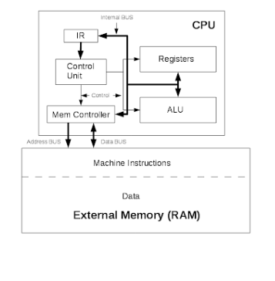
Block Diagram

Slide 6
Data transfer operation
– >In this type of operation, the data is transferred from a source to a destination.
For ex: LOAD X, STORE Y
>Here LOAD is memory read operation that is data is transfer from memory to accumulator and STORE is memory write operation that is data is transfer from accumulator to memory.

Slide 7
ALUoperation – >In this type of operation, arithmetic operations are performed on the data.
For ex: MULT X
>where X is the address of the operand. The MULT instruction in this example performs the operation,
AC <-- AC * M[X]

Slide 8
>AC is the Accumulator and M[X] is the memory word located at location X.
>This type of CPU organization is first used in PDP-8 processor and is used for process control and laboratory applications.
>It has been totally replaced by the introduction of the new general register based CPU.

Slide 9
Advantages
One of the operands is always held by the accumulator register. This results in short instructions and less memory space.
Instruction cycle takes less time because it saves time in instruction fetching from memory.

Slide 10
Disadvantages
When complex expressions are computed, program size increases due to the usage of many short instructions to execute it. Thus memory size increases.
As the number of instructions increases for a program, the execution time increases.

Slide 11
Reference
"HC16 Overview". Freescale.com. Archived from the original on 28 September 2007. Retrieved 2008-09-22.
^ J. Presper Eckert, "A Survey of Digital Computer Memory Systems", IEEE Annals of the History of Computing, 1988, pp. 15-28.
^ "The Feasibility of Ludgate's Analytical Machine".
^ Jump up to:ª ^{b} Haigh, Thomas; Priestley, Mark; Ropefir, Crispin (2016). ENIAC in Action: Making and Remaking the Modern Computer. MIT Press. ISBN 9780262334419.
^ Digital Equipment Corporation, Maynard, Massachusetts (1961) "PROGRAMMED DATA PROCESSOR-1 MANUAL", page 7: PDP-1 system block diagram accessdate=2014-07-03. The PDP-1 was an 18-bit processor, and was a predecessor of PDP-8

Slide 12
THANK YOU

